Slide 1
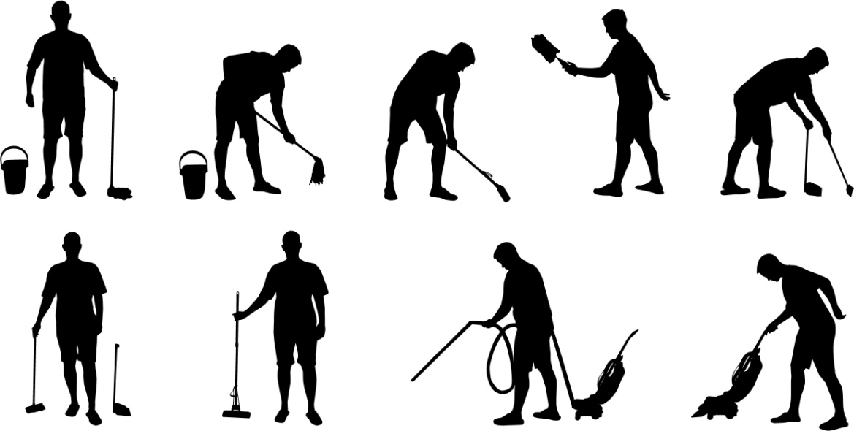
Clean public areas, facilities and equipment
D1.HHK.CL3.02
Notes:
Trainer welcome trainees to class.

Slide 2
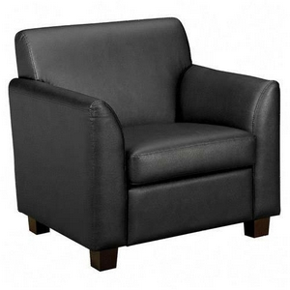
Subject Elements
This unit comprises an introduction and seven Elements:
Introduction
Apply leather upholstery cleaning techniques
Apply fabric upholstery cleaning techniques
Apply glass surfaces cleaning techniques.
Notes:
Trainer advises this Unit comprises an introduction and seven Elements, as listed on this slide and the next slide explaining:
The introduction serves to provide detailed information relating to the cleaning of public areas.
• Each Element comprises a number of Performance Criteria which will be identified throughout the class and explained in detail
• Trainees can obtain more detail from their Trainee Manual
• At times the course presents advice and information about various protocols but where their workplace requirements differ to what is presented, the workplace practices and standards, as well as policies and procedures must be observed.

Slide 3
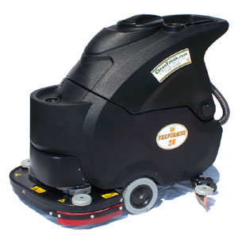
Subject Elements
This unit comprises an introduction and seven Elements:
Apply ceilings, surfaces and fittings cleaning techniques
Apply wet area cleaning techniques
Apply pressure washing techniques
Apply high level cleaning techniques.
Notes:
Trainer advises this Unit comprises an introduction and seven Elements, as listed on this slide and the previous slide explaining:
The introduction serves to provide detailed information relating to the cleaning of public areas.
• Each Element comprises a number of Performance Criteria which will be identified throughout the class and explained in detail
• Trainees can obtain more detail from their Trainee Manual
• At times the course presents advice and information about various protocols but where their workplace requirements differ to what is presented, the workplace practices and standards, as well as policies and procedures must be observed.

Slide 4
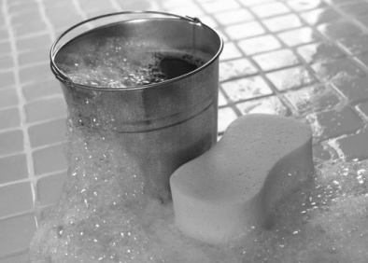
Assessment
Assessment for this unit may include:
Oral questions
Written questions
Work projects
Workplace observation of practical skills
Practical exercises
Formal report from supervisor.
Notes:
Trainer advises that assessment for this Unit may take several forms all of which are aimed at verifying they have achieved competency for the Unit as required.
Trainer indicates the methods of assessment that will be applied to them for this Unit.

Slide 5
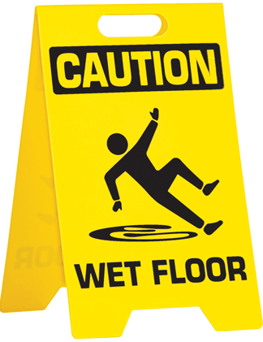
Clean Public Areas, Facilities and Equipment
Introduction
Notes:
Introduce topic.
Class Activity – General Discussion
Ask general questions:
What is a ‘public area’?
Who cleans a ‘public area’?
What types of cleaning need to be performed?
What is needed to be able to do this cleaning?

Slide 6
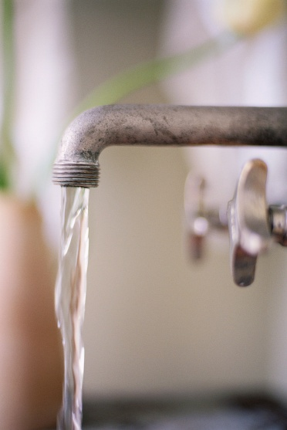
Introduction
The introduction is to give a detailed understanding regarding all aspects of cleaning public areas, facilities and equipment as it relates to general cleaning.
The elements of competency will describe how to undertake cleaning activities relating to specific types of cleaning.
Notes:
Class Activity – Clarification
The introduction provides detailed information regarding cleaning. It applies to general cleaning.
Hence the introduction is quite extensive.
The elements of competency relates to specific types of cleaning. These will be smaller as they discuss separate cleaning activities.

Slide 7
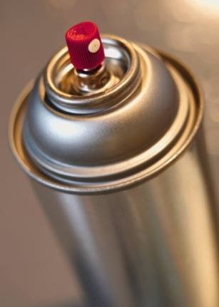
Introduction
The purpose of the introduction is to provide detailed information relating to:
Understanding public areas, facilities and equipment
Types of cleaning equipment
Preparing the work area
Using equipment correctly and safely
Types of cleaning agents and chemicals.
Notes:
Class Activity – General Discussion
Introduce the points. These will be covered during the introduction.

Slide 8

Introduction
The purpose of the introduction is to provide detailed information relating to:
Types of surfaces to be cleaned
Disposal of garbage and used chemicals
Cleaning and maintaining PPE
Cleaning equipment after use
Storing equipment and chemicals safely.
Notes:
Class Activity – General Discussion
Introduce the points. These will be covered during the introduction.

Slide 9
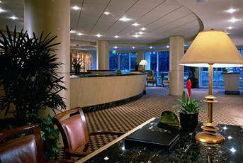
Introduction
One of the basic requirements that a customer of a hospitality business has is that an organisation is clean and tidy.
It must:
Match and exceeds cleanliness found in a normal household
Look clean and tidy
Be aesthetically pleasing
Be free from dangers that can pose a hygiene or safety risk.
Notes:
Class Activity – Discussion
As a customer, what level of cleanliness do you expect at a hotel?
What will you accept and not accept?

Slide 10
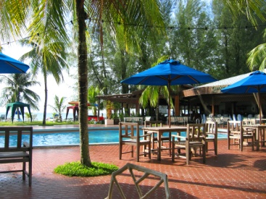
Key definitions
Before we can start to discuss cleaning methods involved, it is important to identify and discuss these three key terms:
Public areas
Facilities
Equipment.
Notes:
Class Activity – Discussion
What is included in each of these terms?

Slide 11
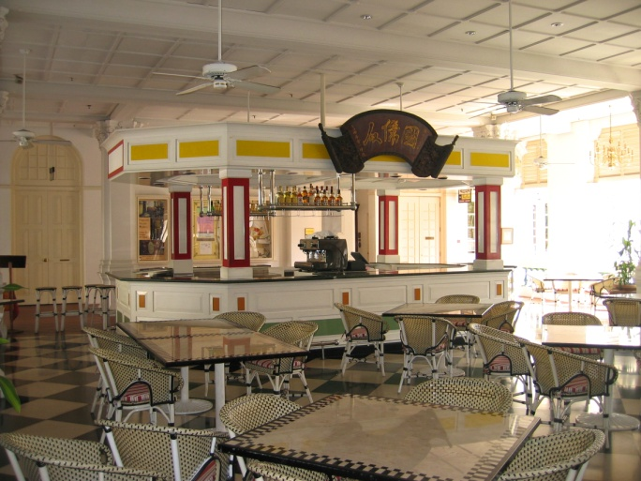
Public areas
A public space is any area within a hospitality organisation that is readily available for all customers to enjoy.
Public areas include:
Lobby
Restaurants
Bars
Outlet shops.
Notes:
Class Activity – Discussion
What is the difference between a ‘private’ and ‘public’ area?
What areas are considered ‘private’ and who can access these?
What makes the locations in this slide ‘public’ areas?
Discuss the types of cleaning and cleaning expectations to be undertaken in each of these locations.

Slide 12

Public areas
Public areas include:
Elevators
Public toilets
Corridors
Gardens
Swimming pools
Gymnasiums
Play areas
Car park
Notes:
Class Activity – Discussion
What makes the locations in this slide ‘public’ areas?
Discuss the types of cleaning and cleaning expectations to be undertaken in each of these locations.

Slide 13

Facilities
Facilities are aspects of products and services within these public areas.
It can include:
Furniture commonly refers to items in the room that are movable including tables, chairs and sundecks
Fixtures refer to items that are attached including heaters, air-conditioners and lights
Fittings refers to taps, pipes and electrical aspects of a public space.
Notes:
Class Activity – Discussion
What cleaning activities need to be performed to keep facilities clean?

Slide 14
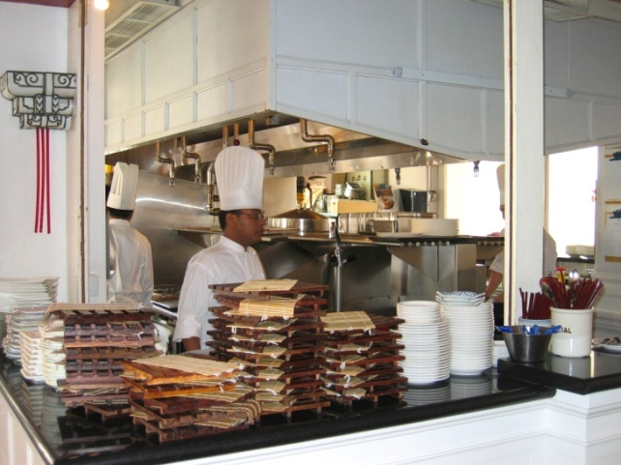
Equipment
Equipment is defined as the items within the public area that are used, their by customers or staff.
Examples of equipment can used by staff include:
Buffet areas
Kitchen equipment.
Notes:
Class Activity – Discussion
Think about a city hotel and a resort.
In each of these types of establishments:
How many of each would exist?
Where would they be located?
Are they indoors or outdoors?
Are they in public view?
Who is responsible for cleaning them?

Slide 15

Equipment
Examples of leisure equipment used by customers include:
Games – board games, ping pong tables
Sporting goods – golf clubs
Gym equipment – water tanks, weights, machines
Pool equipment – inflatable equipment and balls
Leisure machinery - jet skis, boats
Playground equipment
Notes:
Class Activity – Discussion
What other types of equipment do customers use?
How are they cleaned?
Who cleans them?
When should they be cleaned?

Slide 16
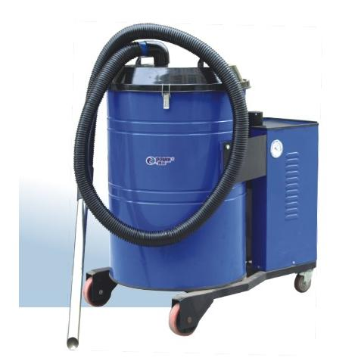
Types of cleaning equipment
The type of cleaning equipment found in businesses will vary.
Generally, commercial or industrial equipment is better be cause it is:
Sturdier
Larger capacity
Fitted with larger electric motors.
Notes:
Class Activity – Discussion
What types of cleaning equipment exist?
What is their purpose?
Where can you get these from?

Slide 17
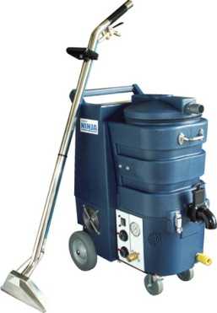
Types of cleaning equipment
Cleaning equipment is commonly divided into two categories:
Manual Cleaning Equipment
Electrically Powered Equipment.
Notes:
Class Activity – Discussion
What are some examples of each?
What are the benefits of each?

Slide 18
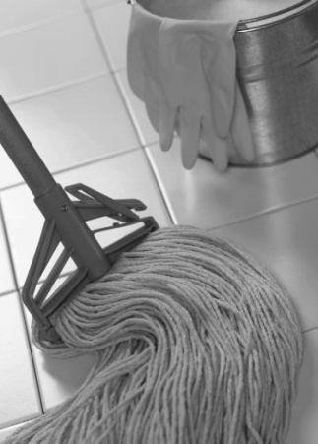
Manual cleaning equipment
Mops
The three main types of mops are:
Dusting mops
Polishing mops
Washing mops.
Notes:
Class Activity – Discussion
Dusting mops – to clean skirting boards and polished surfaces
Polishing mops – for buffing and polishing
Washing mops – to wash floor surfaces or apply sealant to floors that have been stripped and need to be re-sealed.

Slide 19
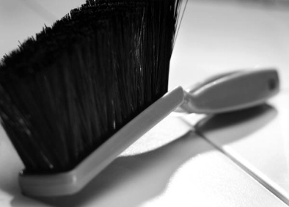
Manual cleaning equipment
Brooms and brushes
The most common types of brooms and brushes are:
Carpet brush
Scrubbing brush
Sink brush
Silk brush
Toilet brush
Wall brush
Soft broom
Hand brush
Notes:
Class Activity – Discussion
What is each type of brush used for?

Slide 20
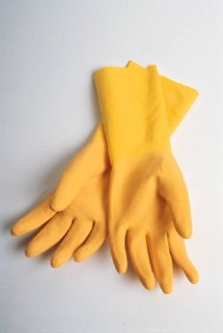
Manual cleaning equipment
Personal protective equipment (PPE)
Overalls, jackets and aprons (material aprons and PVC aprons)
Thick rubber gloves, PVC gloves, gauntlets
Cotton glove inserts
Breathing apparatus
Waterproof clothing and footwear/rubber boots
Eye protection, safety glasses
Enclosed shoes and steel-capped boots
Notes:
Class Activity – Discussion
What is each type of PPE used for?

Slide 21
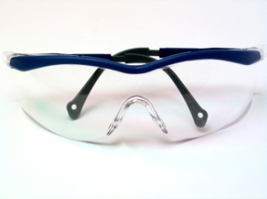
Manual cleaning equipment
Personal protective equipment (PPE)
Safety hats, hard hats, headwear and helmets
Goggles and face masks
Uniform
RCD devices.
Notes:
Class Activity – Discussion
What is each type of PPE used for?

Slide 22

Manual cleaning equipment
Personal protective equipment (PPE)
Where staff are required to work outside in the elements, PPE can include:
Sun hats/broad brimmed hats
Sun glasses
Sun protection
Rain coats
Warm clothing
Notes:
Class Activity – Discussion
What is each type of PPE used for?

Slide 23
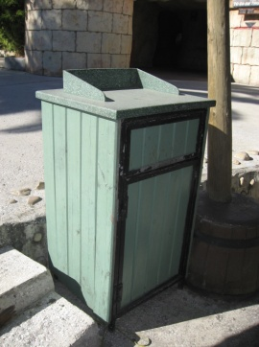
Manual cleaning equipment
Garbage receptacles
Nearly all cleaning tasks will require you to gather and dispose of debris, rubbish and waste.
The ‘receptacle’ may be:
A solid item –such as a bin
A disposable plastic bag – usually heavy-duty
A bin liner placed inside a garbage receptacle that is built-in to a cleaning trolley
Notes:
Class Activity – Discussion
What is each type of garbage receptacles are there?
How often are they cleaned?
Who does this?
Is recycling options available?

Slide 24
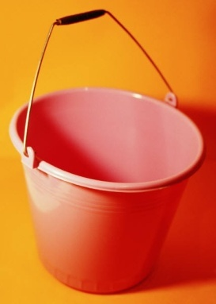
Manual cleaning equipment
Other types of equipment include:
Cloths and sponges
Buckets
Warning signs
Dust pans
Notes:
Class Activity – Discussion
What is each type of equipment used for?

Slide 25
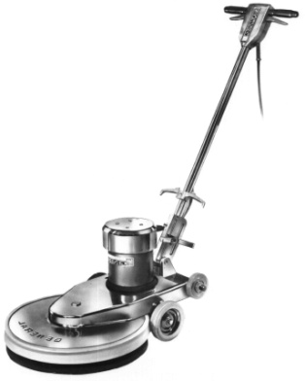
Electrical cleaning equipment
Vacuum cleaners
Carpet shampoo machines
Floor polishers
Scrubbing machines
Floor machines
Notes:
Class Activity – Discussion
What is the purpose of each type of electrical equipment listed in this slide.
Trainer may get the audience to conduct a research exercise to:
Get a detailed description (also refer to the manual notes)
Identify the benefits
Identify the different types available
Identify where these can be obtained?
How much these cost?

Slide 26
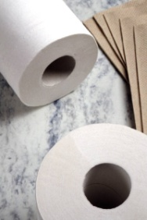
Equipment complementary items
Toiletries
There are items that need to be replenished in public area rest rooms and include:
Toilet paper
Tissues
Sanitary bags
Rubbish bags
Soap
Hand towels – cloth or paper
Shampoo and conditioners
Notes:
Class Activity – Discussion
Not only is equipment needed in public areas, attendants must also replace essential toiletries as well.
Where are these items required?

Slide 27
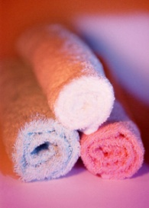
Equipment complementary items
Towels
Beach towels for the pool
Towels for public showers
Replacement items
Batteries to replace worn or stolen batteries in remote control units
Light globes to replace lights
Notes:
Class Activity – Discussion
How do you control towels in public areas to ensure:
They are not stolen?
They are returned to the allocated collection point?

Slide 28
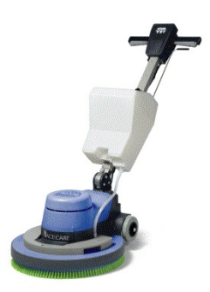
Check equipment is clean, ready and safe
Before using any item of cleaning equipment it must be standard practice to check to make sure the item is:
In a clean condition
Ready to use with all necessary attachments
Safe to use.
Refer to manufacturer’s instructions
Notes:
Class Activity – Discussion & Demonstration
Why is it important to make sure items are clean, ready and safe to use?
Where can you access manufacturer’s instructions
Trainer to demonstrate how to check an electrical item using manufacturer’s instructions.
Trainer may want to show how to access manufacturer’s instructions via the internet. (if no paper format is available)

Slide 29

Check equipment is clean, ready and safe
Importance of checks
Checking is important for a number of reasons:
To avoid mixing chemicals from equipment to equipment
To avoid transferring dirt or grime from one surface to another
To stop transportation of bacteria from one surface to another
To avoid accident and injury
Notes:
Class Activity – Discussion & Demonstration
How can you do these checks?

Slide 30
Check equipment is clean, ready and safe
What do I need to check?
Equipment does not have any jagged parts, edges that can cause injury
Damage to equipment has not affected its operational safety
Check and clean the exterior of cleaning equipment
Ensure equipment points in contact with surfaces clean
Free of leaks, smells or loose attachments
Items to be used need to sufficient in number
Notes:
Class Activity – Discussion & Demonstration
What else would you check?
Equipment does not have any jagged parts, edges that can cause injury.
Damage to equipment has not affected its operational safety.
Check and clean the exterior of cleaning equipment – to enhance presentation and project a positive image for the company when seen by patrons. Cleaning equipment must be clean itself.
Ensure mop head looks presentable - customers will be able to see these if you are working in public areas and may infer a lack of cleanliness in other parts of the establishment.
Buckets should be free of leaks, not smelly and have secure handles.
Check and clear around the rollers on mop buckets to avoid the build up of debris and fibers from the mop.
Items to be used need to sufficient in number – you need to have enough cleaning cloths, disposable gloves etc to get the job done.

Slide 31
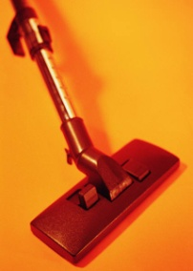
Check equipment is clean, ready and safe
What do I need to check?
Items must be appropriate for task
Make sure all necessary attachments for equipment are taken with you
Used strictly in accordance with manufacturer’s instructions
Ensure electrical cord is safe to use
Ensure battery-operated equipment is fully charged
Notes:
Class Activity – Discussion & Demonstration
What else would you check?
Items must be appropriate for task – many instances of damage or injury have resulted from trying to complete a cleaning job without the right tools
Make sure all necessary attachments for vacuum cleaners, polishers and other equipment are taken with you before leaving the cleaning store to enable you to complete the intended task. This saves time and effort
All electrically-powered and battery-powered items must be used strictly in accordance with manufacturer’s instructions. If you don’t know how to use an item either read the instructions or ask an experienced staff member to show you what to do
A standard check with any piece of electrical equipment is to ensure the electrical cord is safe to use – not frayed or broken and with no wires exposed
Make sure any battery-operated equipment is adequately charged before using it. Low battery power can adversely affect cleaning performance and causes time loss when the job has to be interrupted to remedy the situation.

Slide 32
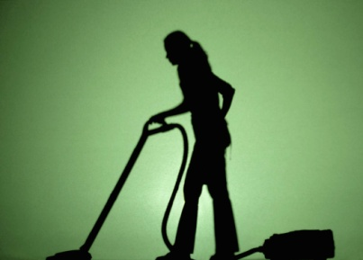
Prepare work area
Minimise customer inconvenience
Common sense must be used when scheduling and performing cleaning tasks.
Two things to think about are:
Timing
Site availability
Notes:
Class Activity – Discussion
When is the best time to clean public areas to ensure minimal customer inconvenience?

Slide 33
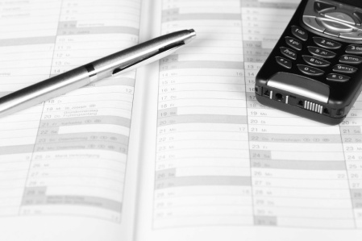
Prepare work area
Consider:
Can the job be completed before the area is needed?
Are there enough staff to handle the job to get it done on time?
Have you got the right chemicals and enough of them to allow the job to be started and finished without interruption?
All the supervisors, clients and users are happy for the intended work to proceed?
Notes:
Class Activity – Discussion
What else would you need to consider?

Slide 34
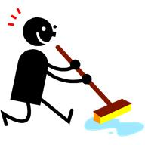
Prepare work area
Whilst it is good to clean when areas are closed, in hotels this is not always the case
Also there will be times when cleaning must be done while people are in the area
Notes:
Class Activity – Discussion
What areas of a hotel never close?
When is immediate cleaning required, regardless of how busy an area is?
How can you clean these areas keeping customer inconvenience to a minimum?

Slide 35
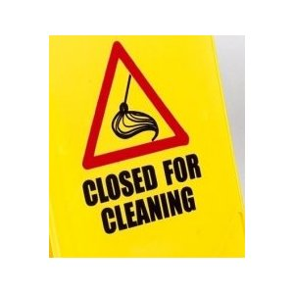
Prepare work area
Cleaning disruptions for customers
Cleaning duties can disrupt customers:
As a result of noise caused during the cleaning activities
Cleaning smells and pollution
By providing a physical obstruction to them when they are moving about
Through unwanted interruption to their activities in the room where you are cleaning
Notes:
Class Activity – Discussion
What types of cleaning are noisy? What can you do to reduce the noise?
What types of smells and pollution are created?
What can you do when you have to close an area for cleaning (toilet) which customers need to use?

Slide 36
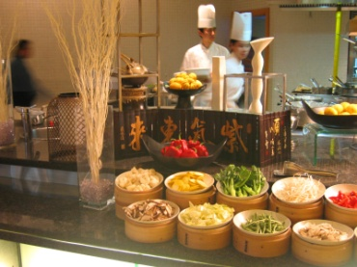
Prepare work area
Cleaning disruptions for staff and business operations
Cleaning duties can disrupt the work of other staff and the operation of the business:
By not being completed by the scheduled time
When cleaning staff and cleaning equipment are present in areas when other staff are delivering service to patrons
By not accommodating unforeseen operational issues into the sequence in which areas are to be cleaned
Notes:
Class Activity – Discussion
What are some examples in delays in cleaning can cause service to be delayed?
By not accommodating unforeseen operational issues into the sequence in which areas are to be cleaned, or into the extent of cleaning to be provided. For example:
A dining room due to be cleaned at 9:30PM is still full of in-house guests who are dining there, spending well and enjoying themselves. Go ahead and do other cleaning duties now and return at 11:00PM to do the dining room
A lobby area due for a full clean is found to be teeming with 300 check-in guests who have just arrived with their luggage on several buses. Just do a spot clean, empty the bins and tidy things up. Leave the vacuum cleaning and scheduled cleaning of the drapes until tomorrow.

Slide 37

Prepare work area
Minimise customer inconvenience
You can further minimise interruption or disruption by:
Observing ‘Do Not Disturb’ signs on guest rooms if you are cleaning them
Keeping noise to a minimum when moving around
Conversing quietly with other staff and guests. Only converse with patrons when they initiate the discussion
Keeping trolleys and cleaning equipment out of high traffic areas
Notes:
Class Activity – Discussion
What other ways can you keep customer inconvenience to a minimum?
Think back to when you were a customer. What cleaning activities caused an inconvenience? What could be changed?

Slide 38
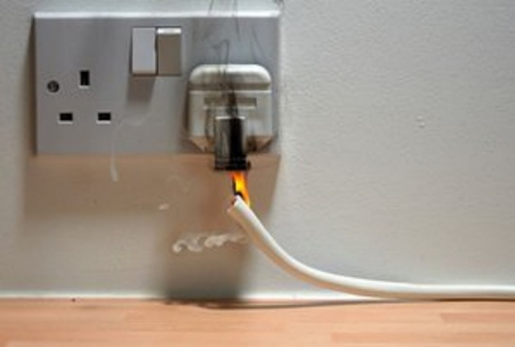
Prepare work area
Identify hazards
Before an area can be cleaned it must be assessed and prepared and cleared of any items and hazards.
What is a hazard?
What type of hazards exist?
How can you identify them?
Notes:
Class Activity – Observation
Trainer to take the audience for a tour around the complex, especially in public areas, to identify types of hazards in the workplace or hospitality environment.

Slide 39
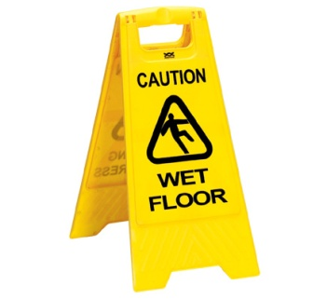
Prepare work area
Types of hazards
Spillages of food and liquids or all types
Breakages of packages, individual items, glass containers
Wet or slippery surfaces
Broken or damaged furniture
Fumes
Blood, human waste, needles, syringes and surgical dressings
Notes:
Class Activity – Discussion
What is the cause of thee hazards?
Where are these hazards normally found?
How can they prevented?
As a cleaner, how can you remove these hazards?

Slide 40

Prepare work area
Types of hazards
Used condoms
Sharp objects including syringes, knives, blades and skewers
Broken glass – from windows, glassware, mirrors
Fat and oil
Hot utensils and surfaces
Sharp food scraps such as bones and crustacean shells
Notes:
Class Activity – Discussion
What is the cause of thee hazards?
Where are these hazards normally found?
How can they prevented?
As a cleaner, how can you remove these hazards?

Slide 41
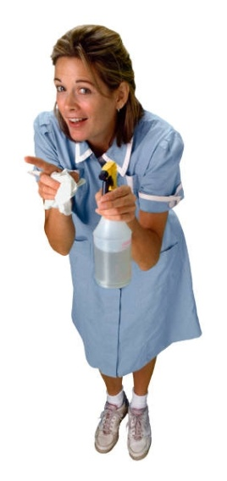
Prepare work area
Basic preparation procedures
Never take chances if you think you may harm or injure yourself, another person or property
Never start a cleaning job if you are concerned for your personal safety
immediately stop any cleaning job where you believe a danger exists
Have all the necessary equipment and materials
Move items that pose a hazard, that might get damaged during the cleaning process
Notes:
Class Activity – Discussion
What activities are involved in each of the basic preparation procedures?
When preparing to clean an area the following should be applied where necessary:
Never take chances if you think you may harm or injure yourself, another person or property. Never start a cleaning job if you are concerned for your personal safety. You should also immediately stop any cleaning job where you believe a danger exists
Make sure you have all the necessary equipment and materials before you start to do the job properly and completely. Some jobs such as stripping and re-sealing a floor can’t be stopped and started
Move items that pose a hazard, that might get damaged during the cleaning process or get in the way of the cleaning process and slow the job down. Items that may need to be moved or removed may include guest property as well as enterprise assets.

Slide 42
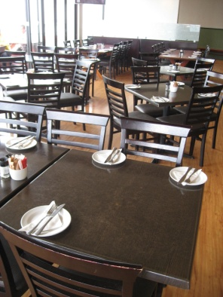
Prepare work area
Basic preparation procedures
Move items ensuring they don’t become hazards such as tripping hazards, obstructions in their own right somewhere else
Ensure the security of any items that have been moved. Keep them in-sight, keep them behind locked doors, put them out of temptation’s way
Replace items that have been moved when the job has been completed
Lock doors where necessary to maintain security
Turn off alarms when entering an alarmed area
Notes:
Class Activity – Discussion
What activities are involved in each of the basic preparation procedures?
Where items have to be moved to allow the cleaning to be done, the items that have to be moved must be removed to a place that doesn’t cause them to become hazards such as tripping hazards, obstructions in their own right somewhere else
Ensure the security of any items that have been moved. Keep them in-sight, keep them behind locked doors, put them out of temptation’s way
Replace items that have been moved when the job has been completed
Lock doors where necessary to maintain security – if you had to unlock a door at night to enter a bar, a room then you should lock that door again once you are inside. This is not so much to lock yourself in, but to lock potential offenders, thieves, out
Turn off alarms when entering an alarmed area.

Slide 43
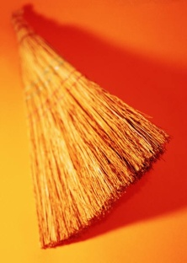
Prepare work area
Preparatory cleaning tasks
Moving the cleaning equipment and materials into a close position
Walking over the area and picking up any loose rubbish
Sweeping the area
Setting up or assembling equipment
Mixing or preparing chemicals and cleaning agents
Deciding where to start the job, the physical direction the work will take and where the job will conclude
Notes:
Class Activity – Discussion
What activities are involved in each of the preparatory cleaning tasks?
Moving the cleaning equipment and materials into a position that will enable them to be readily used – close to the job but not interfering with the work that needs to be done
Walking over the area and picking up any loose rubbish – papers, discarded boxes, large items, by hand and putting them into a rubbish receptacle
Sweeping the area – to remove dust. In some cases ‘sweeping’ may be the entire cleaning job that needs to be done but in many cases, sweeping can be seen as a preparatory task for others jobs such as wet mopping, stripping etc
Setting up or assembling any equipment that needs to be put together
Mixing any chemicals or preparing chemicals and cleaning agents that will be needed
Deciding where to start the job, the physical direction the work will take and where the job will conclude. This is often vital with cleaning tasks because you often don’t want to walk over surfaces that have just been mopped, re-sealed and you have to make sure you don’t trap your self into a corner. Working from the furthest point back to the entry door is a usual work direction.

Slide 44
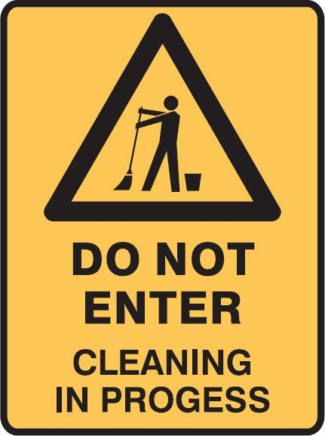
Prepare work area
Barricade the work area or place safety warning signs
Signage and barriers serve three purposes:
They warn people of danger
They help keep people away from the work area
They are evidence that the establishment has discharged its duty of care obligation to others
Notes:
Class Activity – Discussion
When should cleaning signs be used?
Where should they be placed?
Signage and barriers serve three purposes:
They warn people of danger – reducing the risk of injury due to slipping
They help keep people away from the work area – which allows us to work unimpeded and keeps their feet off surfaces that need to dry
They are evidence that the establishment has discharged its duty of care obligation to others.

Slide 45

Prepare work area
Barricade the work area or place safety warning signs
The following points should be followed with reference to barricades and safety signs:
‘Slippery When Wet’ signs must be used when mopping or working with a slippery surface
‘Cleaning in Progress’ signs
Use of physical barriers
Locked doors to deny access
Other workplace signage
Notes:
Class Activity – Discussion
What physical barriers can be used?
What other workplace signage may be required?
The following points should be followed with reference to barricades and safety signs:
•‘Slippery When Wet’ signs must be used when mopping or working with a slippery surface – there must be sufficient of these signs to provide suitable and adequate warning to anyone who may enter the cleaning area from any direction. They must be sufficient to be ‘readily visible’
• During cleaning, ‘Cleaning in Progress’ signs should be posted as a warning to patrons and staff in the same way that Slippery When Wet signs are posted
• Physical barriers and physical restraints (purpose-built safety barriers) may be used to restrict access to a site
• Locked doors are another practical way of denying access to areas and rooms
• Your workplace may have other signage that they require you to erect when cleaning is being done – often the signs that are available will depend on the company from whom they were bought.

Slide 46
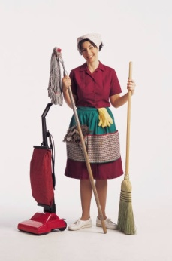
Use equipment safely and correctly
All cleaning equipment should be used correctly, and only used for the purpose for which it was intended.
Don’t use an ordinary vacuum cleaner to soak or clear away liquid
As soon as a fault has been identified it must be reported
The right equipment should only be used on the surface it was designed to clean
Follow manufacturer’s instructions
Notes:
Class Activity – Discussion
What are some common examples where people do NOT use equipment correctly?
Why do they do this?
How can you ensure staff use equipment correctly?
Don’t use an ordinary vacuum cleaner to soak or clear away liquid – you must use one that is classified as a wet vacuum cleaner
As soon as a fault has been identified it must be reported – not only is this a genuine safety concern, but it may also impact on the effectiveness of the item and render it less than totally efficient
The right equipment should only be used on the surface it was designed to clean, in accordance with the manufacturer’s instructions – avoid trying to ‘make do’ with what you’ve got: if you need a special item to clean a certain item/area then you should obtain what is needed and not ‘force’ what you have got to do the job
Follow manufacturer’s instructions.

Slide 47
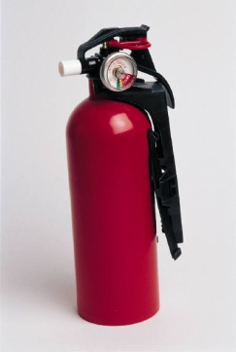
Use equipment safely and correctly
Employer responsibilities
Employer OHS responsibilities may include:
Providing safety training and clear safety rules
Encouraging a Workplace OHS Committee
Maintaining an injury register
Adhering to all workplace agreements that include reference to OHS matters, issues, protection, training, qualified personnel
Notes:
Employer responsibilities
Employer OHS responsibilities may include:
Providing safety training and clear safety rules
Encouraging a Workplace OHS Committee – the aim of the committee is to identify areas in the workplace where changes should be made so as to create a safer working environment: this may include upgrading equipment, equipment training and safety matters
Maintaining an injury register - so that accidents are logged for insurance and monitoring purposes
Adhering to all workplace agreements that include reference to OHS matters, issues, protection, training, qualified personnel etc.

Slide 48

Use equipment safely and correctly
Employee responsibilities
OHS workplace obligations imposed on staff include:
Working in a way that ensures personal safety, and the safety of others
Using safety equipment strictly in accordance with the manufacturer’s instructions
Using all personal protective equipment and clothing
Following all occupational health and safety regulations
Reporting accidents, injuries or illness
Reporting any equipment in need of repair
Notes:
Employee responsibilities
OHS workplace obligations imposed on staff include:
Working in a way that ensures personal safety, and the safety of others including colleagues and customers – this is a legal responsibility to look after your personal welfare and includes the requirement to avoid engaging in activities that can compromise or jeopardise the safety of others including playing around in the workplace
Using safety equipment strictly in accordance with the manufacturer’s instructions – which means avoiding taking short-cuts and avoiding the belief that you have found a better way to do things
Using all personal protective equipment and clothing when and where required and in a correct manner – this means using items such as goggles, masks, gloves, guards every time they are required, no exceptions
Following all occupational health and safety regulations in-line with establishment requirements. A fundamental for doing this is to know what these requirements are: if you don’t know or aren’t told. Ask!
Reporting accidents, injuries or illness to the appropriate person – so that help can be provided where needed or appropriate action taken to prevent an accident from occurring where a hazard has been reported, prevent a repeat event occurring, minimise damage, loss or injury
Reporting any equipment in need of repair.

Slide 49
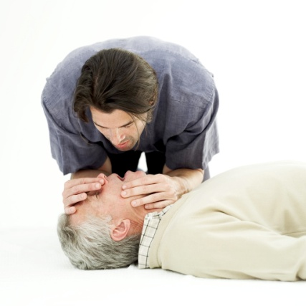
Use equipment safely and correctly
Employee responsibilities
Adhering to all workers’ compensation laws and regulations including:
Complying with reporting requirements in relation to the accident
Participating in Return To Work programs
Not interfering or getting in the way of a person who is trying to assist another in need
Notes:
Class Activity – Discussion
What legal requirements must staff follow?
What organisational responsibilities do staff have in relation to safety in the workplace?

Slide 50
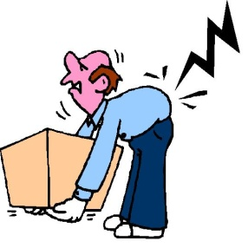
Use equipment safely and correctly
Safe manual handling practices
Manual handling activities are the main cause of injuries in the workplace including:
Lifting – of equipment, chemical containers, cartons
Carrying – items from storage areas to cleaning trolleys, moving items to work areas
Pulling – boxes and cartons forward in storage areas, moving cleaning equipment
Pushing –trolleys and cleaning equipment
Notes:
Class Activity – Questions and Demonstration
What equipment can help assist with manual handling?
What techniques should be used to correctly handle items?
Trainer to demonstrate correct manual handling techniques.

Slide 51

Use equipment safely and correctly
Safe manual handling practices
Key points to remember when engaged in manual handling activities are:
Get a risk assessment done on any job you believe poses a threat or hazard
Push cleaning trolleys and cleaning equipment; don’t pull them
Always stock items in their designated place on the trolley
Never lift anything on your own that weighs over 16 kg
Be prepared to ask for help when needed
Notes:
Key points to remember when engaged in manual handling activities are:
Get a risk assessment done on any job you believe poses a threat or hazard – involve your Health and Safety representatives and Committee. (where applicable)
Push cleaning trolleys and cleaning equipment; don’t pull it. It is important for you to see where you are going
Always stock items in their designated place on the trolley - it is best to position heavy items on the bottom to prevent the trolley from overturning. If you are not sure where things go – ask!
Never lift anything on your own that weighs over 16 kg – this is a recommendation from OHS authorities. There are no maximum weight restrictions as the current approach to workplace safety is to assess every lifting need on an individual basis and use the most appropriate technique depending on the type of load, how far it has to be moved, the size of the load etc. Chemicals can be delivered in drums of 25 litres and 20 kgs
Be prepared to ask for help when needed – this may be a request for help such as to do a ‘team lift’ or a request for information. You must also be prepared to provide help when required.

Slide 52
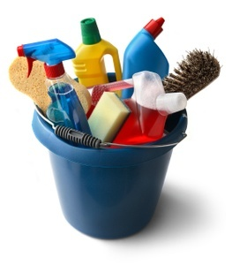
Cleaning agents and chemicals
Safe handling of chemicals
Whenever you are required to deal with chemicals employers are under a legal obligation to provide you with:
Appropriate and sufficient training and information
Adequate monitoring and supervision
Necessary safety equipment and protective clothing
Notes:
Class Activity – Questions
What types of chemical training is needed?
Who should provide this training?
What safety equipment is needed when handling chemicals?
What protective equipment is helpful when handling chemicals?

Slide 53
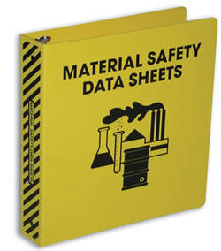
Cleaning agents and chemicals
Material Safety Data Sheets
Employers are also required to ensure that all chemicals used in the workplace are accompanied by a Material Safety Data Sheet (MSDS) covering issues including:
Product classification
Storage requirements
Transportation regulations
Safe handling procedures
First aid
Notes:
Class Activity – Demonstration
Trainer to show and explain contents of Material Safety Data Sheets.

Slide 54

Cleaning agents and chemicals
Selecting and preparing chemicals for use
Chemicals may be delivered in:
Liquid form – most detergents, cleaners, sanitisers, and disinfectants
Dry/powder form – some detergents come in this dry/powder form
Aerosol form – for pesticides and deodorisers
Paste form – polishes
Notes:
Class Activity – Questions & internet research
Trainer to get trainers to:
Conduct internet research on major chemical suppliers
Identify types of chemicals they provide
Prepare a list of chemicals and cleaning agents under each of these headings.

Slide 55
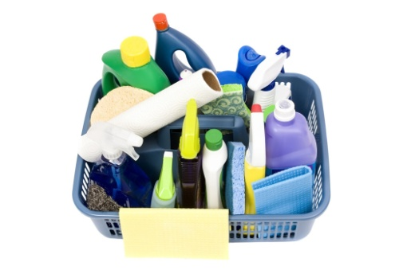
Cleaning agents and chemicals
Dilute properly
Read the label and use the chemical correctly
Some chemicals will be used undiluted
Always measure chemicals, never guess at how much you are using.
Always follow the manufacturer’s instructions
Notes:
Class Activity – Questions
Which chemicals are usually diluted?
What is the ratio of chemical to water?
How do you measure ratios?

Slide 56
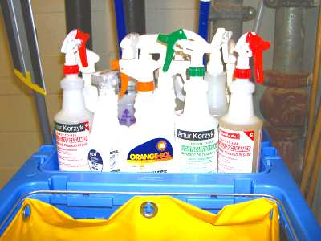
Cleaning agents and chemicals
Follow relevant work procedures
Where the employer has specific, written directions that relate to selection, preparation and application of chemicals these must be followed.
They can take the form of:
Job Instructions
Checklists
Job Safety Analysis
Work Instructions
Notes:
Class Activity – Demonstration
Trainer to show and explain workplace procedures used in hotels in relation to using chemicals.

Slide 57

Types of cleaning agents and chemicals
Water
Used to dilute chemicals
Loosen and dissolve dirt and grime from surfaces
Rinse surfaces and cleaning equipment
Always use clean water
Notes:
Class Activity – Questions
What are the benefits of using water as a cleaning agent?

Slide 58
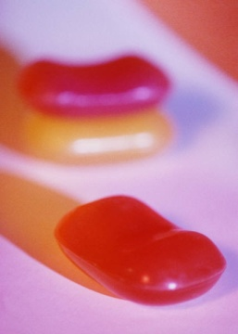
Types of cleaning agents and chemicals
Soap
Generally, soap is made from animal fats and caustic soda
Soap can be an effective cleaning agent for some surfaces, but it can leave an unacceptable and unattractive residue
In general terms, soap is not used for cleaning equipment and surfaces
Notes:
Class Activity – Questions
What are the benefits of using soap as a cleaning agent?
What do you need to do to remove soap from surfaces?

Slide 59
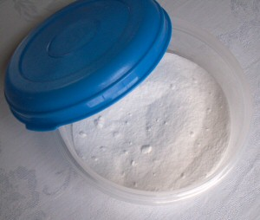
Types of cleaning agents and chemicals
Polishes
Polish can come as a paste, liquid or cream form
Polish protects surfaces and forms a barrier against liquids that may harm the surface
Spirit-based polishes are generally used for metal surfaces as well as windows and mirrors
Oil-based polishes are generally used for leather, wood, synthetic flooring, linoleum and tiles
Notes:
Class Activity – Questions
What are some polishes you use in your everyday life?
What polishes do you use in the workplace?
What are the benefits of polishes?

Slide 60
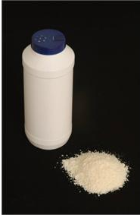
Types of cleaning agents and chemicals
Abrasives
Abrasive cleaning agents are available in powder, cream or paste forms
They are used for scouring and cleaning ceramic or enamel surfaces
An example of such a surface is the toilet bowl or the shower base
Abrasive cleaners must not be used on surfaces that scratch easily
Notes:
Class Activity – Questions
What are some abrasives you use in your everyday life?
What abrasives do you use in the workplace?
What are the benefits of abrasives?

Slide 61
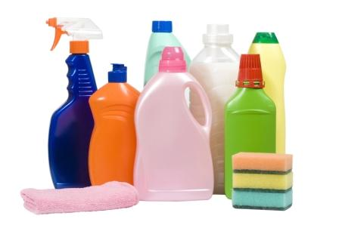
Types of cleaning agents and chemicals
Detergents
Detergents are chemical-based and can vary in strength
Acidic detergents (pH of 1 to 6) should be used for cleaning ceramic surfaces
Neutral detergents (pH of 7) are useful for general cleaning
Alkaline detergents (pH of 8 to 14) should be used only for specialist tasks, as they can be corrosive and have the ability to damage a surface
Notes:
Class Activity – Questions & Demonstration
What are some abrasives you use in your everyday life?
What abrasives do you use in the workplace?
What are the benefits of abrasives?
Trainer to provide examples of each type of detergent as identified in this slide.

Slide 62
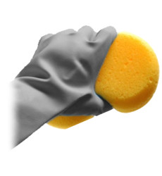
Types of cleaning agents and chemicals
Solvents
Solvent-based detergents will dissolve heavy grease and oil
It is most important to realise that not all surfaces can be cleaned with solvent detergents
Surfaces that have been cleaned with solvents must be rinsed thoroughly to remove any harmful residue
Notes:
Class Activity – Questions & Demonstration
What are some solvents you use in your everyday life?
What solvents do you use in the workplace?
What are the benefits of solvents?
Trainer to provide examples of solvents explaining their purpose.

Slide 63
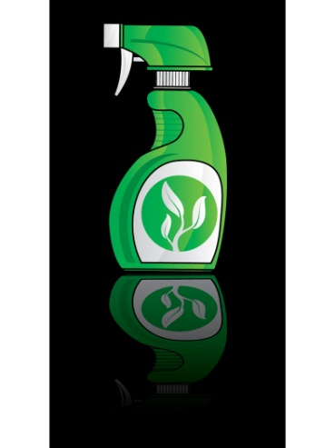
Types of cleaning agents and chemicals
Disinfectants
Disinfectants are cleaning agents that destroy disease-carrying micro-organisms.
Disinfectants have a strong scent and so are not suitable for use in a kitchen or any food area
Disinfectants should be used only in the toilet, bathroom and change areas
Notes:
Class Activity – Questions & Demonstration
What are some disinfectants you use in your everyday life?
What disinfectants do you use in the workplace?
What are the benefits of disinfectants?
Trainer to provide examples of disinfectants explaining their purpose.

Slide 64

Types of cleaning agents and chemicals
Deodorisers
Deodorisers are used to mask or eliminate unpleasant smells
They are commonly in aerosol form and should sprayed sparingly to achieve their aim but not dominate or over-power
Notes:
Class Activity – Questions & Demonstration
What are some deodorisers you use in your everyday life?
What deodorisers do you use in the workplace?
What are the benefits of deodorisers?
Trainer to provide examples of deodorisers explaining their purpose.

Slide 65

Types of cleaning agents and chemicals
Specialised cleaning agents
Cleaning chemicals have been developed to address specific cleaning tasks.
These ‘specialty’ products have been developed for:
A range of floor and carpet cleaning needs
Windows and glass
Stainless steel
Leather
Aluminum
Toilets
Various laundry uses
Cleaning specific equipment and areas
Notes:
Class Activity – Questions & Demonstration
What are some specialised cleaning agents you use in your everyday life?
What specialised cleaning agents do you use in the workplace?
What are the benefits of specialised cleaning agents?
Trainer to provide examples of specialised cleaning agents explaining their purpose.

Slide 66

Types of cleaning agents and chemicals
Environmental issues
As businesses seek to reduce their pollution levels, carbon footprints and overall energy usage, there has been growing concern about the use of chemicals.
Monitoring the green chemical movement
Seeking environmentally-friendly chemicals
Training staff in the correct usage of chemicals
Securing the chemical store
Disposing of chemicals in environmentally sensitive ways
Notes:
Class Activity – Questions and research
What are other ways a company can be environmentally friendly?
The trainer may wish to get the audience to research other environmental trends and make a presentation to the class.

Slide 67

Types of surface to be cleaned
There are a number of different surfaces that need to be cleaned in public areas.
Common surfaces to be cleaned within a hospitality organisation include, but not limited to:
Leather upholstery – chairs and couches
Fabric upholstery – curtains, chairs, couches
Glass surfaces – mirrors, windows and glass tables
Ceilings, walls, surfaces and fittings
Wet areas – floors
Notes:
Class Activity – Question and Explanation
What equipment and cleaning agents are used to clean each of these surfaces?
The Trainer does not need to go into too much detail. Let the audience know, the specific techniques for cleaning each of these surfaces will be explained in each of the Elements of Competency.

Slide 68
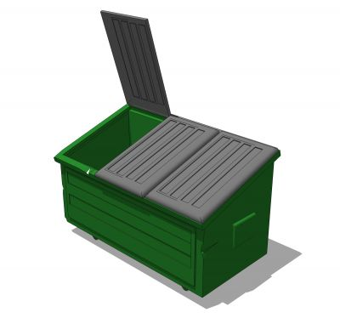
Disposal of garbage and used chemicals
Garbage must be transported safely to the appropriate garbage location, usually a dump master.
Near the dump master there may be a number of recycling stations– paper, plastics, cans
Protective clothing should be worn
Notes:
Class Activity – Question
What is the normal procedure for disposing of garbage?
What are common items for recycling and how is this done?

Slide 69

Disposal of garbage and used chemicals
Disposal of garbage
Remove all garbage on a daily basis
Comply with any recycling protocols the business has
Make sure all rubbish goes into the bins
Close lids to bins after using them
Liquid waste will be separated from solid waste
Wash hands after handling rubbish
Notes:
Class Activity – Question
What are types of liquid garbage?
How do you dispose of liquid garbage?

Slide 70

Disposal of garbage and used chemicals
Disposal of chemicals
When cleaning, handling and disposing of chemicals:
Always wear PPE
When spilt, chemicals should be initially soaked up with sand, earth or some kind of designated absorbent material
Left-over chemicals in undiluted form must never be disposed of down a sink
Take to designated collection sites
Or arrange collected by specialists
Notes:
Class Activity – Question
What are the procedures for disposing of chemicals in most hospitality businesses?

Slide 71

Cleaning and check PPE
All equipment and PPE must be cleaned before being stored.
This is to enable it to be ready for immediate use and to reduce the chance of being affected by chemicals.
Standard PPE checks include:
Checking for rips and tears to gloves and aprons
Checking for holes and leaks in safety shoes
Verifying the integrity of safety glasses
Replacing the filters in respirators
Notes:
Class Activity – Question
What happens if PPE equipment is damaged?

Slide 72
Clean equipment after use
It is important for all equipment to be cleaned after every use
This will ensure that dirt and grime from a previous cleaning task is not transferred on to another surface
Follow manufacturer’s instructions
Notes:
Class Activity – Questions
What equipment needs to be cleaned?
Who does it?
What are the procedures for cleaning equipment after use?

Slide 73

Clean equipment after use
How do you clean the following types of equipment?
Mops
Dusters
Brooms and brushes
Cloths and sponges
Buckets
Vacuum cleaners
Carpet shampoo machines
Floor machines
Notes:
Class Activity – Questions
How do you clean each type of equipment?
What else do you need to do to get it ready for the next shift?
Please refer to the Training manual which identifies how to clean each type of equipment.

Slide 74

Store equipment after use
All cleaning equipment will have an allocated storage area.
Equipment must be returned to this area after use
Cleaning equipment cannot be left ‘just anywhere’ after it has been used because:
It may be stolen
It may be a hazard in terms of an obstruction or a tripping hazard
Others may need to use it and they will go to where it should be
Notes:
Class Activity – Questions
Where is equipment normally stored?
Who has access to this area?

Slide 75

Store equipment after use
Location for storage
A property can have several small storerooms throughout the property. Normally this is one per department or one per floor
Larger electrically-powered equipment may be stored in another location due to size
These storage areas should all be back-of-house locations and fitted with locks to prevent unauthorised access to equipment
Make sure the store is locked when you leave it
Notes:
Class Activity – Questions
Where is equipment normally stored?
Who has access to this area?

Slide 76

Store chemicals after use
Guidelines for storing chemicals
Keep in a storeroom away from other products
A register should be maintained to record items in accordance with legislated requirements
The store room for chemicals must be well lit and ventilated
The room should only be used for storing chemicals
Heavy containers must be stored on lower shelves to avoid the need for lifting, and to minimise the chance of spills
Notes:
Class Activity – Questions
What is the important of each of these guidelines when storing chemicals?

Slide 77

Store chemicals after use
Guidelines for storing chemicals
Keep containers well sealed and labeled
Have MSDS and first aid directions and resources posted in the area
Keep away from a naked flame or excessive heat
Product usage charts should be close to the chemicals for easy and clear reference purposes
Instructions for safe chemical handling must be posted
Notes:
Class Activity – Questions
What is the important of each of these guidelines when storing chemicals?

Slide 78

Store chemicals after use
Guidelines for storing chemicals
Necessary PPE should be present
Never store chemicals or cleaning agents in food containers
Never store chemicals with food
Do not allow customers to come into contact with chemicals, or entry into the chemicals storage area
Never mix chemicals together
Ensure measuring devices for chemicals are not used for any other purpose
Notes:
Class Activity – Questions
What is the important of each of these guidelines when storing chemicals?

Slide 79


Cleaning public areas
Gardens
Gardens influence the ambiance of the property
Need to be clean and attractive
Some properties have gardeners – others use the public area cleaner.
Gardening responsibilities can include:
Caring for grass and plants
Keeping the gardens neat and tidy
Maintaining gardening equipment & machinery
Maintaining a safe working environment.
Notes:
Class Activity – Questions
Make a list of some of the things a public area cleaner would be expected to do in the gardens.
Which of these tasks would be better done by a gardener?

Slide 80

Cleaning public areas
Swimming pools
The pool is a major attraction for guests
Pools need to be clean and properly maintained.
Pool cleaning tasks can include:
Removing leaves, algae and vacuuming
Keeping water sanitised
Checking filter and maintaining lighting
Using and storing pool chemicals correctly
Keeping the pool environs clean and tidy.
Notes:
Class Activity – Questions
Make a list of some of the things a public area cleaner would be expected to do in the pool area.
Which of these tasks would be better done by a pool cleaning contractor?

Slide 81
Cleaning public areas
Car parks and driveways
The hotel entrance is the first point of contact for guests
It needs to be clean and properly maintained.
Tasks can include:
Keeping driveways clear of rubbish and clean
Keeping car park clean and tidy
Making sure all equipment is in working order
Making sure all vehicles are secure.
Notes:
Class Activity – Questions
Make a list of some of the things a public area cleaner would be expected to do in the car park and driveways areas.

Slide 82

Cleaning public areas
Fire equipment and smoke detectors
Fire equipment is often located in public areas
They need to be checked to see they are operational
Smoke detectors are often placed in public areas
They need to be checked once a month.
To test a smoke detector:
Press the test button and check for beep or ring
If the detector chirps or beeps off and on then it is time to change the battery
When checking smoke detectors also check that sprinkler heads are operational and not broken.
Notes:
Class Activity – Questions
Observe the presence of fire equipment and smoke detectors in the public areas or your workplace or a local hotel. How many did you see?

Slide 83

Conclusion
Conclusion of Introduction
In conclusion, this introduction provided detailed information when it comes to general cleaning functions performed by public area cleaners.
Each of the following sections will detail procedures for different and specific types of cleaning
Notes:
Class Activity – Recap
The trainer may wise to conduct a recap of the topics covered in this introduction including:
Understanding public areas, facilities and equipment
Types of cleaning equipment
Preparing the work area
Using equipment correctly and safely
Types of cleaning agents and chemicals
Types of surfaces to be cleaned
Disposal of garbage and used chemicals
Cleaning and maintaining PPE
Cleaning equipment after use
Storing equipment and chemicals safely.

Slide 84

Element 1:
Apply leather upholstery cleaning techniques
Notes:
Introduce topic.
Class Activity – General Discussion
Ask general questions:
What leather items are located in public areas?
How do you clean them?

Slide 85

Apply leather upholstery cleaning techniques
Performance Criteria for this Element are:
Assess leather upholstery to be cleaned
Select appropriate equipment and chemicals
Prepare work site
Clean upholstery
Tidy work site
Clean, check and store equipment and chemicals
Notes:
Trainer identifies the Performance Criteria for this Element, as listed on the slide.

Slide 86

Leather upholstered furniture
Leather is a popular soft and durable material that is commonly used in furniture.
Leather covered furniture is normally used in chairs and booths in restaurants as it:
Look great
Can resist most spills
Is easy to clean
Notes:
Class Activity – Questions
How do you keep leather clean?

Slide 87

Leather upholstered furniture
Preventative maintenance
As leather is a durable substance, most cleaning to be performed will be as an on-going preventative maintenance
Should be checked daily
Should be wiped daily
Kept out of direct sunlight to prevent drying and cracking the leather
Notes:
Class Activity – Questions
What other preventative maintenance can you perform?

Slide 88

Select equipment & chemicals
Equipment required to clean leather
Vacuum cleaner
Bucket
Soft cloth for cleaning
Soft bristled toothbrushes
Soft cloth for buffing or polishing
Notes:
Class Activity – Questions
What is each of the equipment items identified used for?

Slide 89

Select equipment & chemicals
Cleaning agents required to clean leather
Due to the nature of leather, more often that not, strong chemicals are not used.
Water
Moisturizing soap
Rubbing alcohol
Products recommended by a manufacturer
Notes:
Class Activity – Questions
What is each of the cleaning agents identified used for?
Leather Protection Cream - is a leather conditioner is used to protect leather that repels stains and protects the surface from wear and tear. It feeds, protects and re-instates the smell into old and new leather items.

Slide 90

Cleaning leather
Immediate cleaning
Use a moisturizing soap
Lather on with a soft cloth
Wash the item to remove dirt and grime
Do not over-wet the leather
Do not rinse after washing
Buff with a soft cloth
This allows the moisturizing soap to condition the leather
Polish as usual
Notes:
Class Activity – Discuss steps and/or demonstration
Trainer to discuss steps and/or provide a demonstration.

Slide 91
Cleaning leather
Regular cleaning
Wiping of leather furniture at the end of a shift, or two or three times a week with a soft rag.
Leather should be dusted or wiped with clean rags two to three times a week. This will help prevent dust and dirt build up, especially in the crevices.
Don't rub down on your furniture too hard as you may accidentally scratch the surface.
Vacuum the furniture once a week using the vacuum's soft brush attachment
Notes:
Class Activity – Discuss steps and/or demonstration
Trainer to discuss steps and/or provide a demonstration.

Slide 92

Cleaning leather
Removing ink from leather
On occasions ink from pens may spill on leather furniture.
Dip the cotton swab into rubbing alcohol and rub over the ink stain
Dry the area with a blow dryer
If you still see the stain after drying, apply a thick coat of non-gel, non-oily cuticle remover
Leave this on overnight and wipe off with a damp cloth
Notes:
Class Activity – Discuss steps and/or demonstration
Trainer to discuss steps and/or provide a demonstration.

Slide 93

Cleaning leather
Remove dark stains from light coloured furniture
Mix one part creme of tartar with one part lemon juice to form a paste
Rub this paste on the stain, leaving in place for 10 minutes; repeat this step
Remove with a damp sponge or a damp sponge and moisturizing soap
Notes:
Class Activity – Discuss steps and/or demonstration
Trainer to discuss steps and/or provide a demonstration.

Slide 94
Clean area and store equipment
Ensure furniture is dry enough to sit on
Return cushions, blankets and other items to furniture
Place any used cloths in a suitable place for cleaning
Clean and store vacuum cleaner
Place all chemicals and other substances used in a storage area out of reach of children
Notes:
Class Activity – Discuss steps
Why is each of the steps mentioned important?

Slide 95

Element 2:
Apply fabric upholstery cleaning techniques
Notes:
Introduce topic.
Class Activity – General Discussion
Ask general questions:
What fabric items are located in public areas?
How do you clean them?

Slide 96

Apply fabric upholstery cleaning techniques
Performance Criteria for this Element are:
Assess fabric upholstery to be cleaned
Select appropriate equipment and chemicals
Prepare work site
Clean fabric
Tidy work site
Clean, check and store equipment and chemicals
Notes:
Trainer identifies the Performance Criteria for this Element, as listed on the slide.

Slide 97

Fabric upholstered furniture
Benefits of fabric
Fabric upholstery is used on a large amount of furniture items in hotels as it allows for:
Greater flexibilities of colour, patterns, designs and textures
Normally less expensive than leather
Easy to clean
Has removable covers, which limits impact on operations, whilst still providing inter-changeable features
Notes:
Class Activity – Questions
How do you keep fabric clean?

Slide 98
Select equipment & chemicals
Equipment required to clean fabric
Vacuum cleaner
Bucket
Cloths for cleaning and washing away detergent
Drying machines
Wet furniture signs
Notes:
Class Activity – Questions
What is each of the equipment items identified used for?

Slide 99

Select equipment & chemicals
Cleaning agents required to clean fabric
The cleaning materials used to clean fabric is quite simple and standard:
Liquid or powder fabric detergent or liquid washing detergent
Cleaning shampoo
Stain remover
Warm water
Products recommended by a manufacturer
Notes:
Class Activity – Questions
What is each of the cleaning agents identified used for?

Slide 100

Preparing work area
When preparing the work area for cleaning fabric upholstery, considerations include:
Size of cleaning furniture and
Location and frequency of use of the furniture.
Firstly, it is best to conduct cleaning:
When it will have little impact on guests
When it allows for sufficient time to dry before use
Notes:
Class Activity – Question
What activities need to be done when preparing the work area?

Slide 101

Preparing work area
Preparation tasks include:
Place a ‘wet or caution’ sign in a suitable location to ensure customers don’t sit on the furniture whilst it is wet
Remove any items such as newspapers and magazines
Vacuum the furniture and cushions
Notes:
Class Activity – Question
Where should cushions be placed to ensure they don’t go missing or get dirty themselves?

Slide 102
Cleaning fabric
General cleaning
Remove any loose items from the furniture including cushions
Loosen dirt with a handheld dusting brush while using a vacuum brush attachment to remove the dust
Vacuum all surfaces of the furniture: back, sides, arms, skirt and the platform beneath the cushions
Vacuum both sides of the loose cushions
Remove any cushions
If the fabric is removable and inter-changeable, wash separately
Notes:
Class Activity – Discuss steps and/or demonstration
Trainer to discuss steps and/or provide a demonstration.

Slide 103
Cleaning fabric
General cleaning
Mix laundry or other suitable detergent with warm water
Ensure the detergent has dissolved or has been mixed properly
Select a test area to conduct trial cleaning
Let the trial clean dry
If fading, shrinkage or discoloration occurs, you may wish to have it cleaned by experts
If no problems have been identified in the trial cleaning process, go to the next step
Notes:
Class Activity – Discuss steps and/or demonstration
Trainer to discuss steps and/or provide a demonstration.

Slide 104

Cleaning fabric
General cleaning
Select an area on the furniture, dip cloth and rub water and detergent mix on the fabric
Dirt or any marks will begin to remove from the fabric
Use a clean cloth and plain water
Rinse area with a damp cloth to ensure detergent has been removed from the fabric
If some stains or dirt remains, you may wish to repeat steps the cleaning steps until it is suitably clean
Allow to dry overnight
Use a professional air drier if available
Notes:
Class Activity – Discuss steps and/or demonstration
Trainer to discuss steps and/or provide a demonstration.

Slide 105

Cleaning fabric
Deep cleaning
Deep cleaning your upholstered furniture can be done for a number of reasons:
Removes deep stains and accumulated dirt
Helps to keep furniture look like as new as possible
Ensures furniture is as clean as possible, which helps keeps insects and other animals away
Deep cleaning is normally done by external experts
Notes:
Class Activity – Internet research
Trainer to get audience to identify:
Local companies that deep clean fabric upholstery
How much it costs?
Where is it done? (at hotel or at their location)

Slide 106
Cleaning fabric
Deep cleaning
Remove any blankets, covers or cushions
Conduct a thorough vacuum
Replace the cushions back on the furniture
Check your furniture's label for cleaning instructions before washing
Prepare a suitable cleaning agent. This may include a specialised shampoo or stain remover
Similar to regular cleaning, conduct a trial clean
Ensure no further stains or other foreseeable problems have arisen
Notes:
Class Activity – Discuss steps and/or demonstration
Trainer to discuss steps and/or provide a demonstration.

Slide 107
Cleaning fabric
Deep cleaning
Spot treat any existing stains with a suitable stain remover
Prepare hot water and add detergent or cleaning shampoo into a large bucket. Ensure that the mixture is well mixed
Use a rough cloth or brush to clean the upholstery but gently putting part of the cloth into the soapy solution. Do not to soak the fabric
Use a clean damp cloth to soak up the dirty soap, and rinse with a damp cloth
Let the furniture dry overnight with an airing fan pointed at the wet furniture to help it dry more quickly
Notes:
Class Activity – Discuss steps and/or demonstration
Trainer to discuss steps and/or provide a demonstration.

Slide 108

Tidy work site
Considerations
Once the cleaning has taken place, whether through the process of a regular or deep clean, it is important that the furniture has:
Time to dry
Does not attract any dirt or dust during the drying process
Notes:
Class Activity – Discuss steps
Why is each of the considerations mentioned important?

Slide 109

Tidy work site
Steps
If the furniture is to remain in its usual location, please ensure:
All equipment has been removed
All cushions, blankets and other items to be placed on the furniture is returned
The surrounding area is clean and dry
Notes:
Class Activity – Discuss steps
Why is each of the steps mentioned important?

Slide 110

Clean area and store equipment
Ensure furniture is dry enough to sit on
Return cushions, blankets and other items to furniture
Place any used cloths in a suitable place for cleaning
Clean and store vacuum cleaner
Place all chemicals and other substances used in a storage area out of reach of children
Notes:
Class Activity – Discuss steps
Why is each of the steps mentioned important?

Slide 111

Element 3:
Apply glass surfaces cleaning techniques
Notes:
Introduce topic.
Class Activity – General Discussion
Ask general questions:
What glass surfaces are located in public areas?
How do you clean them?

Slide 112

Apply glass surfaces cleaning techniques
Performance Criteria for this Element are:
Assess glass surfaces to be cleaned
Select appropriate equipment and chemicals
Prepare work site
Clean glass surfaces
Tidy work site
Clean, check and store equipment and chemicals
Notes:
Trainer identifies the Performance Criteria for this Element, as listed on the slide.

Slide 113

Fabric upholstered furniture
Types of glass
Glass is used in many hotels as it is very effective in improving the aesthetics of an area and giving the appearance of more space
Glass is commonly found in:
Windows
Mirrors
Coffee tables
Showers
Notes:
Class Activity – Questions
What different types of glass items are located in a hotel?
How do you keep glass clean?

Slide 114

Select equipment & chemicals
Equipment required to glass surfaces
Scrubber
Squeegee
Equipment belt or bucket
Window Cleaning Buckets
Window Scrapper
Window Cleaning Towels
Extension Poles
Ladder
Notes:
Class Activity – Questions
What is each of the equipment items identified used for?
Please refer to the manual for detailed comment relating to each piece of equipment.

Slide 115

Select equipment & chemicals
Cleaning agents required to clean glass surfaces
The cleaning materials used to clean glass surfaces is quite simple and standard:
Commercial window cleaning agents
Homemade window cleaning liquids
Notes:
Class Activity – Questions & Internet research
What are common types of commercial window cleaners?
How can you make your own window cleaner? What ingredients are in it? (This may be a good internet research session)
What is each of the cleaning agents identified used for?

Slide 116

Preparing work area
When preparing to clean, it is vital that the area in which you are going to clean is free from any obstacles that may either get in your way or may get covered in cleaning products or water.
Remove any items off a glass surface, if you are dealing with a coffee table
Remove any furniture away from windows and unplug any items (electrical cords for lamps) that may get in the way of your walking or ladder areas
Remove items from underneath a mirror
Notes:
Class Activity – Question
No discussion required.

Slide 117
Cleaning glass surfaces
Cleaning a window
Scrubbing
Look carefully at a glass surface before you start to clean
Look for things like scratches, cracks, chips, hard water spots, paint, stucco, silicone or cement
If very dirty, give it a pre-wash
Using your scrubber or a natural sponge, soak the entire window
Notes:
Class Activity – Discuss steps and/or demonstration
Trainer to discuss steps and/or provide a demonstration.

Slide 118
Cleaning glass surfaces
Cleaning a window
Scrubbing
Use your squeegee to remove the dirty water
Rewet the window and begin to scrub
When scrubbing a window, start with the edges
Scrub back and forth, up and down along each edge
Start scrubbing from the top and work your way down to the bottom using small circular motions
Notes:
Class Activity – Discuss steps and/or demonstration
Trainer to discuss steps and/or provide a demonstration.

Slide 119

Cleaning glass surfaces
Cleaning a window
Scrapping
Start with the edges
Scrape from the inside of the window towards the outside edge
Work all the way around the window with a one to two inch pattern
After the edges are scraped, start from the top and work your way towards the bottom
Scrape in a straight pattern of about four to five inches while overlapping each time
If the window starts to dry out before your finished, wet it again and then continue where you left off
Notes:
Class Activity – Discuss steps and/or demonstration
Trainer to discuss steps and/or provide a demonstration.

Slide 120

Cleaning glass surfaces
Cleaning a window
Using a squeegee
The entire window should be wet with soapy water
Wrap a cleaning towels on your index finger
Make sure it is completely dry
Dry all sides and edges
Take your squeegee in hand
Notes:
Class Activity – Discuss steps and/or demonstration
Trainer to discuss steps and/or provide a demonstration.

Slide 121

Cleaning glass surfaces
Cleaning a window
Using a squeegee
Place the rubber blade at the top of the dry right hand edge
Pull the squeegee all the way over to the opposite side of the window
Using your towel, wipe the squeegee blade completely free from water
Repeat the same step to finish the lower half of the window
Wipe the edges
Notes:
Class Activity – Discuss steps and/or demonstration
Trainer to discuss steps and/or provide a demonstration.

Slide 122

Cleaning glass surfaces
Cleaning a mirror
Use a glass cleaning product or combination of white or distilled vinegar and warm water
Find newspaper to use as your cleaning cloth
Crumple the newspaper into usable sizes
Clean the mirror first to remove any heavy dirt or marks
Use plain water to do the pre-cleaning
Notes:
Class Activity – Discuss steps and/or demonstration
Trainer to discuss steps and/or provide a demonstration.

Slide 123

Cleaning glass surfaces
Cleaning a mirror
Use a cloth with a tight weave, which is more soft and non-abrasive
Dip the newspaper into the vinegar water solution after pre-cleaning is finished
Rub the newspaper in slow circles across the mirror
Cover the entire surface of the mirror
Go over the wet areas with a dry portion of newspaper
This will leave the mirror dry and keep drip marks from drying onto the surface
Notes:
Class Activity – Discuss steps and/or demonstration
Trainer to discuss steps and/or provide a demonstration.

Slide 124

Cleaning glass surfaces
Cleaning a coffee table
Take all items off the coffee table including flowers, ashtrays, magazines and newspapers
Wipe the table with a clean dry cloth to remove any dry substances
Spray a glass cleaner or water on the top of the table
Scrub the table with a cloth to remove any hard to get stains
Clean and dry the table with a dry cloth or newspaper
Notes:
Class Activity – Discuss steps and/or demonstration
Trainer to discuss steps and/or provide a demonstration.

Slide 125

Tidy work site
Considerations
Remove all cleaning equipment and products
Ensure all surfaces are clean and dry. This is especially applies to floors which may become dirty or wet
Return all furniture to their original spots
Plug in all electrical appliances
Return any items to coffee tables
In the event of windows, return any shades or shutters to their correct position
Notes:
Class Activity – Discuss steps
Why is each of the considerations mentioned important?

Slide 126
Clean area and store equipment
Please place any used cloths in a suitable place for cleaning
Place all used newspaper pieces in the rubbish bin
Please ensure all pieces of equipment has been cleaned out of all detergents, residual dirt and other waste products, then placed back in a suitable location for further use
Place all chemicals and other substances used in a storage area out of reach of children
Notes:
Class Activity – Discuss steps
Why is each of the steps mentioned important?

Slide 127

Element 4:
Apply ceiling, surfaces and fittings cleaning techniques
Notes:
Introduce topic.
Class Activity – General Discussion
Ask general questions:
What ceiling, surfaces and fittings are located in public areas?
How do you clean them?

Slide 128

Apply ceiling, surfaces and fittings cleaning techniques
Performance Criteria for this Element are:
Assess ceiling, surfaces and fittings surfaces to be cleaned
Select appropriate equipment and chemicals
Prepare work site
Clean ceiling, surfaces and fittings
Tidy work site
Clean, check and store equipment and chemicals
Notes:
Trainer identifies the Performance Criteria for this Element, as listed on the slide.

Slide 129

Ceiling, surfaces and fittings
Ceilings and walls
This can include all walls and ceilings:
Painted
Wooden
Wallpaper
Skirting boards
Notes:
Class Activity – Questions
How do you keep ceilings and walls clean?

Slide 130

Ceiling, surfaces and fittings
Surfaces
All furniture including fridges, tables, cupboards, ledges, bookshelves and desks
Lights and lamps
Decorations and flower vases
Public bathrooms including vanities, toilets and public showers
Rubbish bins
Fixtures refer to items that are attached including heaters, air-conditioners and lights
Notes:
Class Activity – Questions
How do you keep each of these surface types clean?

Slide 131

Ceiling, surfaces and fittings
Fittings
Fittings refers to taps, pipes and electrical aspects of a public space
Notes:
Class Activity – Questions
How do you keep fittings clean?

Slide 132

Select equipment & chemicals
Equipment required to ceilings, surfaces and fittings
Mops
Brooms and brushes
Cloths and sponges
Buckets
Garbage receptacles
Gloves
Cleaning warning signs
Personal protective equipment
Dust pans
Vacuum cleaners
Equipment complimentary items
Notes:
Class Activity – Questions
What is each of the equipment items identified used for?
Please refer to the manual for detailed comment relating to each piece of equipment.

Slide 133
Preparing work area
Conduct work during quiet times
Consider safety
Ensure all items are removed from the cleaning area
Keep all equipment and cleaning products close at hand and out of traffic areas and the reach of customers
Have all ‘cleaning in progress’ signs ready and visible to customers
Allow ample time for drying before customers will be using the area
Notes:
Class Activity – Question
Why are these points important?

Slide 134

Cleaning glass surfaces
Areas to dust and polish
The following areas will need either dusting or polishing:
Air conditioning vents
Doors – including top ledge and handles
Picture frames – facing glass as well as frame
Mirrors – frame and mirror
Skirting boards
Windows – glass and frames
Notes:
Class Activity – Questions
Do you need to dust or polish each of these areas differently?
Is there any specific preparation you would need to do in relation to each of these items before they could be dusted or polished?

Slide 135

Cleaning glass surfaces
Areas to dust and polish
Window sills
Walls – check for cobwebs and marks
Lamps – base, shade and cord
Telephone – main unit and hand receiver
Seat furniture – don’t forget to remove cushions and check sides, legs, back and underneath
All furniture – top, sides, legs, and underneath each item
Notes:
Class Activity – Questions
Do you need to dust or polish each of these areas differently?
Is there any specific preparation you would need to do in relation to each of these items before they could be dusted or polished?

Slide 136

Cleaning glass surfaces
Dusting
The main purpose of dusting is to collect small particles of dust
Dusting may be done with a duster or a damp lint-free cloth
Don’t use a damp cloth if the moisture could ruin the object being cleaned
Change the cloth when soiled
Notes:
Class Activity – Discuss steps and/or demonstration
Trainer to discuss steps and/or provide a demonstration.

Slide 137

Cleaning glass surfaces
Polishing
The main purpose of polishing is to clean the item and leave a shiny, reflecting finish.
When polishing an item, make sure to:
Spray the cleaning agent onto the cloth - not onto the surface to be cleaned
Buff the surface after cleaning to remove any streaks
Notes:
Class Activity – Discuss steps and/or demonstration
Trainer to discuss steps and/or provide a demonstration.

Slide 138

Vacuum floors
All carpeted areas should be vacuumed and many non-carpeted areas including wooden floors, tiled bathroom area and linoleum floors may also require vacuuming
Notes:
Class Activity – General Discussion
What is the purpose of vacuuming?

Slide 139

Vacuum floors
Vacuuming tips:
Try to vacuum the room starting at the furthest corner from the door and work back toward the exit
Ensure you vacuum around and under all furniture
Particular attention should be placed on the corners of the room, including the skirting boards
bend your knees when cleaning under items
Try to avoid ‘bending over’ the machine
Notes:
Class Activity – General Discussion & Demonstration
Trainer to demonstrate and explain why steps are done as identified in the slide.
Audience members to practice vacuuming.

Slide 140

Cleaning the vanity area
The vanity area normally includes:
Bathroom bench
Basins
Taps
Mirror
Cupboards
Amenities
Soap containers
Notes:
Class Activity – General Discussion
What amenities are normally supplied in the vanity area?
What are appropriate amenities for men?
What are appropriate amenities for women?

Slide 141

Cleaning the vanity area
Clean and dry shelves
Scrub hand basin, rinse, then dry and polish with clean cloth – check plughole
Polish fittings and taps
Clean and dry wall tiles
Clean, dry and polish bench top
Notes:
Class Activity – General Discussion & Demonstration
Trainer to demonstrate and explain why steps are done as identified in the slide.
Members of audience to practice cleaning a vanity area.

Slide 142

Cleaning the vanity area
Clean and polish mirror
Check under vanity for cleanliness
Replenish stock – soap, tissues, facial items, shower caps
Replenish towels – cloth or paper
Conduct final check
Notes:
Class Activity – General Discussion & Demonstration
Trainer to demonstrate and explain why steps are done as identified in the slide.
Members of audience to practice cleaning a vanity area.

Slide 143

Cleaning the shower
Wet shower basin and sides
Clean tiles and floor – check plughole for foreign matter
Clean shower curtain – check pole is clean and all hooks are in place and working
Rinse walls and floor thoroughly
Polish fittings
Replenish supplies
Conduct final inspection – leave shower curtain neat and to one side
Notes:
Class Activity – General Discussion & Demonstration
Trainer to demonstrate and explain why steps are done as identified in the slide.
Audience members to practice cleaning a shower.

Slide 144

Cleaning the toilet
Flush toilet to wet sides of bowl
Pour in cleanser – leave to soak: continue with other work
Wash lid and dry – both sides and near back hinges
Wash seat and dry – both sides and near back hinges
Wash outsides of the bowl and dry
Notes:
Class Activity – General Discussion & Demonstration
Trainer to demonstrate and explain why steps are done as identified in the slide.
Audience members to practice cleaning a toilet.

Slide 145

Cleaning bins
Waste bins should be properly cleaned by:
Tying the bin liner around the rubbish or emptying the bin directly into your waste bag on the trolley. Remove larger and non-dangerous by hand to facilitate this process where applicable
Spraying bin with appropriate multi-purpose cleaner, inside and out
Cleaning with the appropriate cloth
Fitting a new bin liner
Notes:
Class Activity – General Discussion & Demonstration
Trainer to demonstrate and explain why steps are done as identified in the slide.
Audience members to practice cleaning a bin.

Slide 146
Clean area and store equipment
Steps
Please place any used cloths in a suitable place for cleaning
Place all used newspaper pieces in the rubbish bin
Ensure any rubbish taken from rubbish bins are placed in the external rubbish areas with recycling functions conducted in line with company policy.
Notes:
Class Activity – Discuss steps
Why is each of the steps mentioned important?

Slide 147
Clean area and store equipment
Steps
Please ensure all pieces of equipment has been cleaned out of all detergents, residual dirt and other waste products, then placed back in a suitable location for further use
Place all chemicals and other substances used in a storage area out of reach of children
Notes:
Class Activity – Discuss steps
Why is each of the steps mentioned important?

Slide 148
Element 5:
Apply wet area cleaning techniques
Notes:
Introduce topic.
Class Activity – General Discussion
Ask general questions:
What is wet cleaning?
What does it involve?

Slide 149

Apply wet area cleaning techniques
Performance Criteria for this Element are:
Assess wet areas to be cleaned
Select appropriate equipment and chemicals
Prepare work site
Clean wet areas
Tidy work site
Clean, check and store equipment and chemicals
Notes:
Trainer identifies the Performance Criteria for this Element, as listed on the slide.

Slide 150

Wet area cleaning
What is ‘wet area’ cleaning?
There are many public areas in a hotel that contain wet areas.
These are floor areas that can be classified as areas that either:
Commonly have wet surfaces
Requires water to clean them
Notes:
Class Activity – Questions
How areas have wet surfaces and how do you clean them?
What areas require water to clean them?

Slide 151
Wet area cleaning
The types of surfaces that are usually wet or require water to clean them include:
Wood
Carpet
Marble
Rubber
Tiles
Concrete
Vinyl
Notes:
Class Activity – Questions
What is the best way to clean these types of surfaces?

Slide 152

Wet area cleaning
Some points to keep in mind:
When should it be cleaned routinely?
When is an ‘immediate clean required?
When is the most appropriate time to clean it to keep customer disruption to a minimum?
What do I need to clean it?
How do I clean it?
Notes:
Class Activity – Questions
Discuss the questions in the slide.

Slide 153
Select equipment & chemicals
Equipment required to conduct wet area cleaning
Mops
Brooms and brushes
Cloths and sponges
Buckets
Carpet shampoo machines
Polishers
Scrubbing machines
Floor machines
Notes:
Class Activity – Questions
What is each of the equipment items identified used for?
Please refer to the manual for detailed comment relating to each piece of equipment.

Slide 154

Preparing work area
When preparing to clean a floor using a wet method is to ensure the floor area to be cleaned is free from any furniture or other objects
This may involve stacking tables and chairs to a side, or placing chairs on a table so the floor area is clear
Normally this type of cleaning is done at night when there are less customers in the public areas such as the lobby or when specific outlets are closed, such as the pool area, gymnasium and restaurants
Notes:
Class Activity – Question
Why are these points important?

Slide 155

Cleaning wet areas
Mopping
Remove everything that may be on the floor such as mats, trash cans, and small pieces of furniture
Sweep the floor to remove dirt, hair, dust, and other debris
Dissolve detergent into warm water using the manufacturer's instructions for the correct water to detergent ratio
Pour the solution over the entire floor so that the solution can fill into the grout lines
Allow the solution to remain on the floor for 15 to 20 minutes
Scrub the grout with a small medium-bristled brush
Notes:
Class Activity – General Discussion & Demonstration
Trainer to demonstrate and explain why steps are done as identified in the slide.
Audience members to practice mopping.

Slide 156

Cleaning wet areas
Rinse the floor with a mop dampened with clean water
Mix a second batch of detergent and water
Mop the entire floor with the fresh solution
Rinse the mop with clean water and mop a second time over the floor to rinse it
Use a squeegee to push residual moisture to one area of the floor before absorbing it with dry towels
Notes:
Class Activity – General Discussion & Demonstration
Trainer to demonstrate and explain why steps are done as identified in the slide.
Audience members to practice mopping.

Slide 157
Tidy work area
At the completion of cleaning it is important to ensure the public area is left in a clean and tidy state
More importantly, the surfaces must be dry or safe for customers to use
If it absolutely essential that customers must use an area which contains a wet surface, adequate warning signs and barriers should be put into place
Once the follow is dry, all equipment and furniture should be returned to their original location and all ‘wet floor’ caution signs removed
Notes:
Class Activity – Discuss steps
Why is each of the steps mentioned important?

Slide 158

Clean area and store equipment
Steps
Please place any used cloths in a suitable place for cleaning
Please ensure all pieces of equipment has been cleaned out of all detergents, residual dirt and other waste products, then placed back in a suitable location for further use
Place all chemicals and other substances used in a storage area out of reach of children
Notes:
Class Activity – Discuss steps
Why is each of the steps mentioned important?

Slide 159

Element 6:
Apply pressure washing techniques
Notes:
Introduce topic.
Class Activity – General Discussion
Ask general questions:
What is pressure washing?
What does it involve?

Slide 160

Apply wet area cleaning techniques
Performance Criteria for this Element are:
Assess areas to be pressure washed
Select appropriate equipment and chemicals
Prepare work site
Clean areas using pressure washer
Tidy work site
Clean, check and store equipment and chemicals
Notes:
Trainer identifies the Performance Criteria for this Element, as listed on the slide.

Slide 161
Wet area cleaning
What is pressure washing?
Pressure washing has become a popular cleaning method as it is a:
Quick process
Effective method
Relies on a machine to do the hard work of dirt removal, rather than the exertion of manual labour.
With public areas closed for small periods of time, or not at all, in many hotel outlets, cleaning methods that are quick, effective and simple will always be a preferred option
Notes:
Class Activity – Questions
What types of equipment can you use to pressure wash?

Slide 162

Select equipment
Machine
There are many types of equipment.
Nozzles & tips
Most pressure cleaning machines will come with interchangeable spray tips that serve two purposes:
To lower the pressure and draw the detergent
Deliver a high pressure rinse at the different spray angles
Notes:
Class Activity – Research activity
Trainer to get the audience to conduct research into:
Different types of machines used to pressure wash
Costs
Benefits and purpose.

Slide 163
Select cleaning agents
In essence a pressure cleaning machine will use:
A mixture of detergent and water to clean
Water only to rinse
Some other products used include:
Film removers
Degreasers
Notes:
Film removers – used for removing layers of dirt and grim using a light pressure clean. This includes the cleaning of cars, paths, roads (main driveway) and outdoor areas
Degreasers - used for removing heavy greaser and industrial cleaning.

Slide 164

Preparing work area
When preparing work area using pressure cleaning the main thing to consider is what you are going to clean
Care needs to be taken when pressure cleaning around windows, flowers and garden vegetation, vents, eaves or light fixtures
Check for any holes, dents and scratches on the frame of the window that can allow water to come inside a window or property
Close doors and turn off electronic automatic doors
Notes:
Class Activity – Question
Why are these points important?

Slide 165
Pressure cleaning steps
Cleaning steps using a pressure washing machine include:
Place any safety equipment on including closed shoes, waterproof clothing and safety glasses
Connect the machine to a water source
Attach the nozzle or tip and ensure it is correctly attached
Start the machine
Test the power of the pressure washer
Start spraying few feet away from any object
Notes:
Class Activity – General Discussion & Demonstration
Trainer to demonstrate and explain why steps are done as identified in the slide.
Audience members to practice pressure cleaning.

Slide 166
Pressure cleaning steps
Slowly bring your wand to 3-4 feet distance from the surface you want to clean
Move your wand side-to-side a couple of times and check if the surface is clean
If additional cleaning is needed, move your wand gradually closer to the surface
Start to clean using a side to side motion
Keep the nozzle low and start closer to the body and then move the cleaning action further away until you find the right blend of pressure to clean and accuracy
When washing walls start from the bottom and move up
Notes:
Class Activity – General Discussion & Demonstration
Trainer to demonstrate and explain why steps are done as identified in the slide.
Audience members to practice pressure cleaning.

Slide 167
Pressure cleaning steps
If you are to clean windows, clean from the side
Do not apply a direct ‘face-on’ contact. Check to ensure that water is not leaking inside
When cleaning the ground, start at lower areas and work your up
You may need to scrub areas that a pressure cleaner cannot remove stains
Let the cleaning solution do its work for 20 minutes. This allows for the detergent to start dissolving the dirt, but do not let it sit too long so that it dries out
When ready to rinse start at the top and work towards the bottom until entire area is detergent free
Notes:
Class Activity – General Discussion & Demonstration
Trainer to demonstrate and explain why steps are done as identified in the slide.
Audience members to practice pressure cleaning.

Slide 168
Tidy work area
At the completion of cleaning it is important to ensure the public area is left in a clean and tidy state
More importantly, the surfaces must be dry or safe for customers to use
If it absolutely essential that customers must use an area which contains a wet surface, adequate warning signs and barriers should be put into place
Once the follow is dry, all equipment and furniture should be returned to their original location and all ‘wet floor’ caution signs removed
Notes:
Class Activity – Discuss steps
Why is each of the steps mentioned important?

Slide 169
Clean area and store equipment
Steps
Please ensure all pieces of equipment has been cleaned out of all detergents, residual dirt and other waste products, then placed back in a suitable location for further use
Place all chemicals and other substances used in a storage area out of reach of children
Notes:
Class Activity – Discuss steps
Why is each of the steps mentioned important?

Slide 170

Element 7:
Apply high level cleaning techniques
Notes:
Introduce topic.
Class Activity – General Discussion
Ask general questions:
What is high level cleaning?
What does it involve?

Slide 171

Apply wet area cleaning techniques
Performance Criteria for this Element are:
Assess high level areas to be cleaned
Select appropriate equipment and chemicals
Prepare work site
Clean high level areas
Tidy work site
Clean, check and store equipment and chemicals
Notes:
Trainer identifies the Performance Criteria for this Element, as listed on the slide.

Slide 172

High level cleaning
What is high level cleaning?
As the title suggest high level cleaning is cleaning of items which are ‘at a high level’ above the ground
High level cleaning is more difficult that other types of cleaning identified to date and in most cases requires the use of specialised staff to perform these cleaning duties
Notes:
Class Activity – Questions
What types of equipment can you use to undertake high level cleaning?

Slide 173

High level cleaning
Types of high level cleaning
High level lights and chandeliers
High ceilings and ceiling beams
High exhaust extraction fans in kitchens
Cleaning external windows on high rise hotels
Skylights
Sculptures
Foyer glass
Signs and banners
Notes:
Class Activity – Questions
How would you clean each of these items?

Slide 174

Select equipment
If the job is to be performed by a staff member, common equipment includes:
Ladders
Safety ropes
Extension poles
High pressure cleaning equipment
Cranes – this normally requires specialised staff to operate
Notes:
Class Activity – Research activity
What are each type of equipment used for?
What other equipment could you use to perform high level cleaning?

Slide 175
Preparing work area
The most important aspect is ensuring that equipment used to raise you to a certain height is safe, grounded and placed on a secure and level ground
You need to prepare any equipment and cleaning materials in a manner that allows for each access when you are ‘at height’
Notes:
Class Activity – Question
Why are these points important?

Slide 176

Preparing work area
This may require the use of a cleaning tool belt containing adequate cloths and cleaning agents
You may also need to rope off the area so that customers and staff do not wander into the space and either come in contact with ladders or have items fall on them
Notes:
Class Activity – Question
Why are these points important?

Slide 177

Preparing work area
It is also wise to have another person with you to:
Support the ladder
Pass items up and down
Pass comment
Direct passers-by
Notes:
Class Activity – Question
Why are these points important?

Slide 178

Preparing work area
When cleaning at height, it is natural that any dirty items will fall down.
Think about the furniture directly under where cleaning will take place and make necessary arrangements including:
Removing the item
Covering the item with sheets or other protective materials
Notes:
Class Activity – Question
Why are these points important?
What can you cover items with?

Slide 179

High level cleaning
High level cleaning uses a combination of cleaning methods already identified in this power point presentation.
Use of specialists
In most cases high level cleaning will be conducted through the use of professionals.
What specialists are there?
What types of services do they provide?
Notes:
Class Activity – Research activity
Trainer to get audience to conduct research activity to answer the questions in the slide.

Slide 180
Tidy work area
You may be required to:
Remove to coverings you have placed on furniture
Conduct a vacuum, sweep or mop of the area
Ensure the floor is dry
Once the follow is dry, all equipment and furniture should be returned to their original location and all ‘wet floor’ caution signs removed
Notes:
Class Activity – Discuss steps
Why is each of the steps mentioned important?

Slide 181
Clean area and store equipment
Steps
Please ensure all pieces of equipment has been cleaned out of all detergents, residual dirt and other waste products, then placed back in a suitable location for further use
Place all chemicals and other substances used in a storage area out of reach of children
Notes:
Class Activity – Discuss steps
Why is each of the steps mentioned important?

Slide 182

Finish:
Thank you!
Notes:
This is the conclusion of the subject.
Trainer thanks the class and deliver assessments as required.

